Slide 1
Basic Details of the Team and Problem Statement
PSID: KVH-001
Problem Statement Title: New Age Women Safety App
Team Name: Virtual Blues
Team Leader Name: Shashank Shekhar Pandey
Institute Name: Gyan Ganga Institute of Technology and Sciences

Slide 2
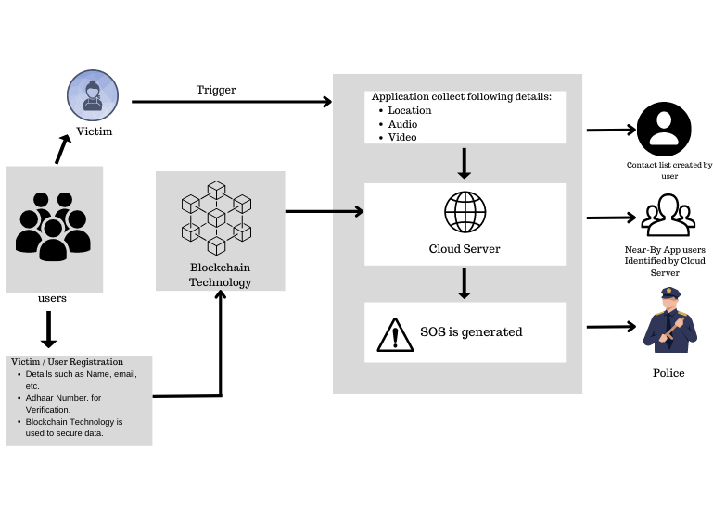
Idea/Approach Details
Describe your idea/Solution/Prototype here:
Providing a triggering device to signal app to send emergency SOS to authorized person.
User authentication is verified by aadhaar using Aadhaar authentication API.
Registration data is protected by Solana Blockchain Technology and stored on cloud server. (Solana can quickly generate a block and accommodate up to 20,000 transactions in a single block. )
When the app is triggered :-
It will start collecting location details.
We will sync the audio recorder of smartphone with the application for collecting audio details.
All the details will be stored in cloud Server.
After getting all the data, cloud server will do :-
Identify nearby police stations and send victim details and location details.
It identifies nearby app users and sends the victim's basic data and location details to the device as a popup.
A contact list (created by the user) allows SOS to receive details and take appropriate action, as well as the ability to share details with the nearest police station.
If internet connectivity is not present, the app will send an SMS to the members of contact list asking for help, for performing this task we will be using Twilio API.
MVP ( Minimum Viable Product ) is almost ready to test.
Describe your Technology stack here:
ESP-32 ( Bluetooth Module )
APIs used: Aadhaar authentication API, Google Map API,
SMS Services: Twilio API.
Frontend (UI/UX) / Developer tools : Figma, Flutter
Solana Blockchain Technology.
GCP (Google Cloud Server )

Slide 3
Idea/Approach Details
Describe your Use Cases here
Describe your Dependencies / Show stopper here
With just a few taps on the phone, the app can quickly connect users to emergency services in risky situations.
The app enables location tracking, allowing women to share their location details with trusted contacts.
The software enables users to document instances of harassment, violence, or other safety issues, as well as to record audio proof. These instances can be reported to the police or shared with reliable contacts for future action.
The app can provide a platform for women to connect with a supportive community of other women and social worker. This can create a sense of solidarity and empowerment.
The app provides comprehensive safety tips, guidelines, and resources related to personal safety, self-defense, legal rights, and emergency contacts. This can empower women with knowledge and information to make informed decisions and take appropriate actions in different situations.
This app provide users with a reliable and convenient way to call for emergency assistance in times of crisis, helping to promote the safety and security of individuals, including women, in vulnerable situations.
Dependencies:-
Victim
UIDAI (for user authorization)
Cloud Services
Android User
Triggering Device
Stoppers:
The app is designed to receive triggers or alerts from external devices such as Bluetooth devices, this allows for discreet activation of the app without needing to open the app on the phone, making it quick and easy to use during an emergency
The app prioritize user privacy and data security, using Solana Blockchain Technology, to protect the user information and collected location and audio information from unauthorized access.
The collected location and audio information can be stored securely in the cloud, ensuring that the data is not lost even if the user's phone is damaged or confiscated.
The app can capture and record audio information from the user's surroundings, such as conversations or sounds, when triggered.

Slide 4
Team Member Details
Sr. No. | Name of Team Member | Branch (Btech/Mtech/PhD etc): | Stream (ECE, CSE etc): | Year | Position in team (Team Leader, Front end Developer, Back end Developer, Full Stack, Data base management etc.)
1 | Shashank Shekhar Pandey | B.Tech | CSE | 2 | Team Leader
2 | Udyan Saxena | B.Tech | CSE | 2 | Frontend Dev.
3 | Shruti Shrivastava | B.Tech | CSE | 2 | UI/UX designer
4 | Mohd Faiz Ansari | B.Tech | CSE-IOT | 2 | Hardware Dev.
5 | Muhammad Amaan Ansari | B.Tech | CSE-IOT | 2 | Blockchain Dev.
6
Team Mentor/s Details
Sr. No. | Name of Mentor | Category (Academic/Industry): | Expertise (AI/ML/Blockchain etc): | Domain Experience (in Years )
1 | Dr. Ruchi Patel | Academic | DS/NLP/ML | 10
2

